Slide 1
World Population
Pranav Salunke
Srijitha Somangili
Melanie Lum

Slide 2
Questions explored
Will the population worldwide stabilize, that is will the worldwide fertility rate approach 2.1?
Which countries make up the top 61% of the world’s population in 2020?
Which countries of Interest had the most extreme (negative and positive) rate of population change for the Medium Variant? (first derivative and second derivative)
How will the general world population change from 1950 until 2100 based on different variants as defined by the UN?
Which variant (out of the 7) will result in the greatest population in 2100? (ignoring: ConstantFertility, ConstantMortality)
The nine are: ESTIMATES, MEDIUM VARIANT, HIGH VARIANT, LOW VARIANT, CONSTANT FERTILITY
INSTANT-REPLACEMENT, MOMENTUM, ZERO-MIGRATION, NO CHANGE, CONSTANT MORTALITY
How will countries’ populations change until 2100 (% of population)?

Slide 3
Data Sources
Code References
UN total population data (csv)
UN 2017 methodology (reference)
Each variant csv
UN fertility rates data (xlsx)
Each variant csv
Countries list (csv)
First country list dataset (txt)
decided not to use
Intermediate and final data sets
Pranav:
Make gifs
Create doughnut graph
Srijitha:
Create a Choropleth graph
How to make a consistent legend
Melanie:
Make dictionary from keys
How to move legend outside plot

Slide 4
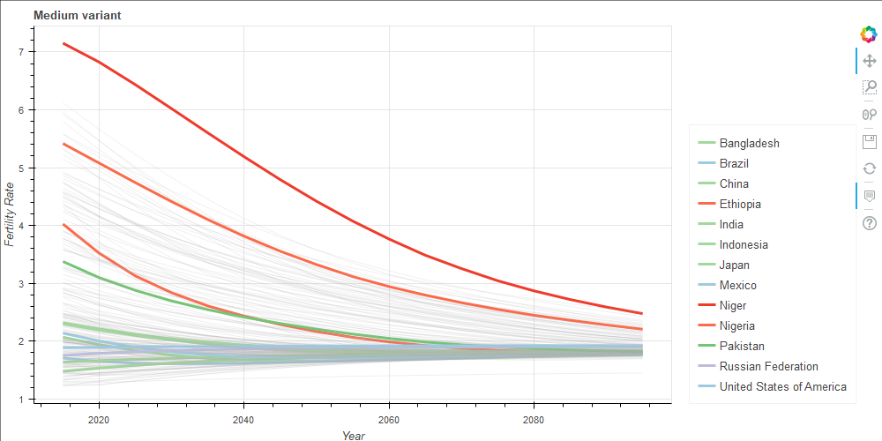
Answers Provided or Final Results Obtained
Will the population worldwide stabilize, that is will the worldwide fertility rate approach 2.1?
Fertility rates seem to stabilize around 2.1

Slide 5
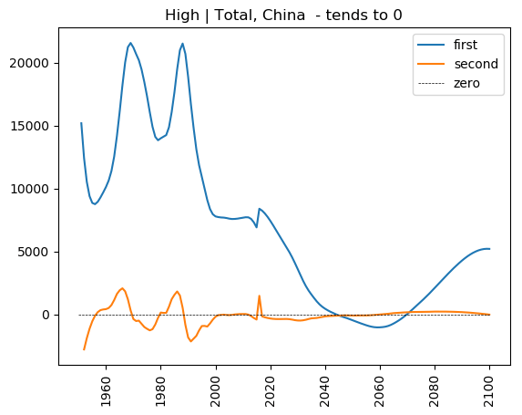
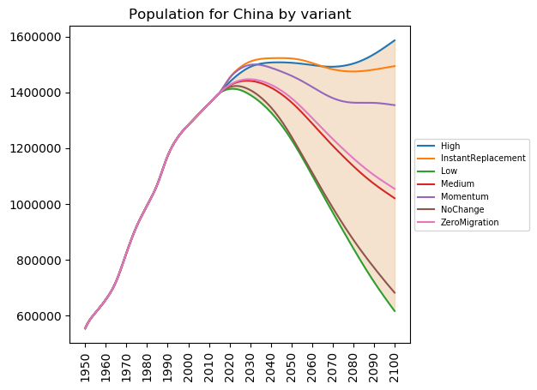
Answers Provided or Final Results Obtained
Which countries of Interest had the most extreme rate of change for the Medium Variant?
China had the most extreme rates of change:
highest first derivative: China: 21568 ppl/yr highest second derivative: China: 2082 ppl/yr^2
lowest first derivative: China: -8150 ppl/yr lowest second derivative: China: -2773 ppl/yr^2

Slide 6
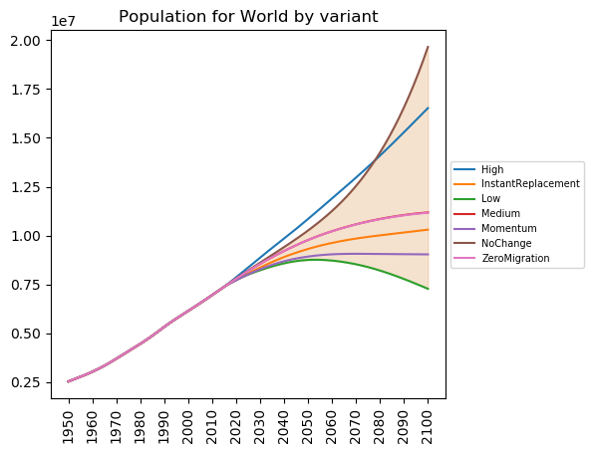
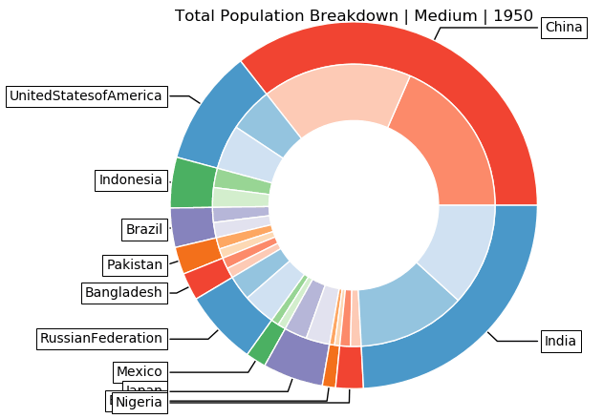
Answers Provided or Final Results Obtained
How will the world population change based on different variants?
Which variant will result in the greatest population in 2100?
Keep an eye on Nigeria!

Slide 7
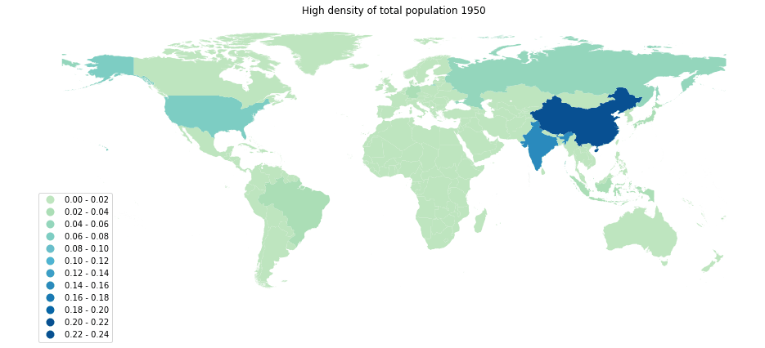
Answers Provided or Final Results Obtained
How will countries’ populations change until 2100 (% of population)?

Slide 8
Tasks
Libraries Used
Data wrangling tasks:
Countries in UN: Srijitha and Pranav
World population: Pranav
Fertility: Melanie
Visualization tasks:
Fertility variant plot: Melanie
Choropleth map: Srijitha
Doughnut graph: Pranav
Fan graph: Pranav
Analysis tasks:
Rate of Change: Pranav
Extremes of Derivatives: Pranav
Pandas
Geopandas
Bokeh
Matplotlib
Numpy
OS
Regular Expressions
Imageio
Shutil

